Slide 1

Final Project
Name: Omar Ali
Yu Id :202111034
This is my project, which is the website of Maestro Pizza Restaurant

Slide 2


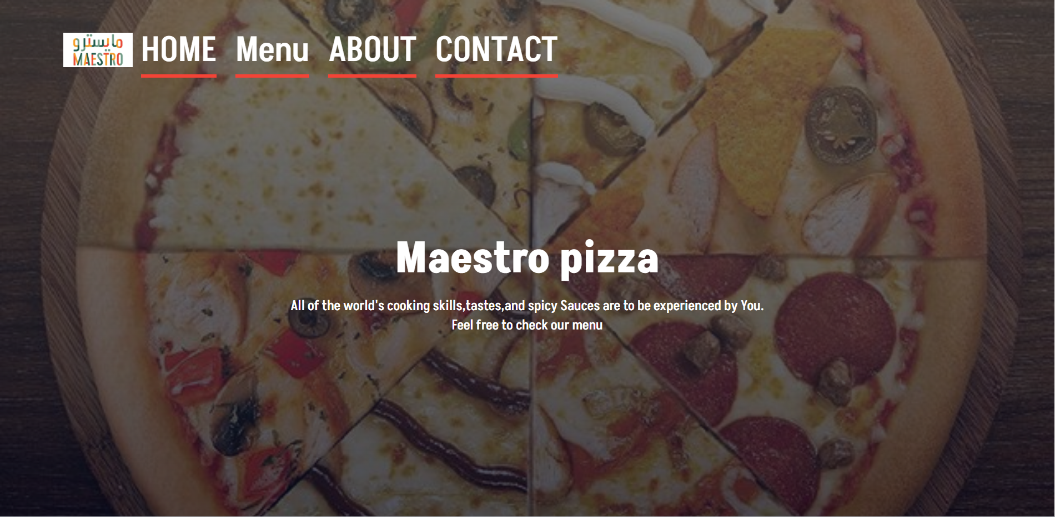



Slide 3
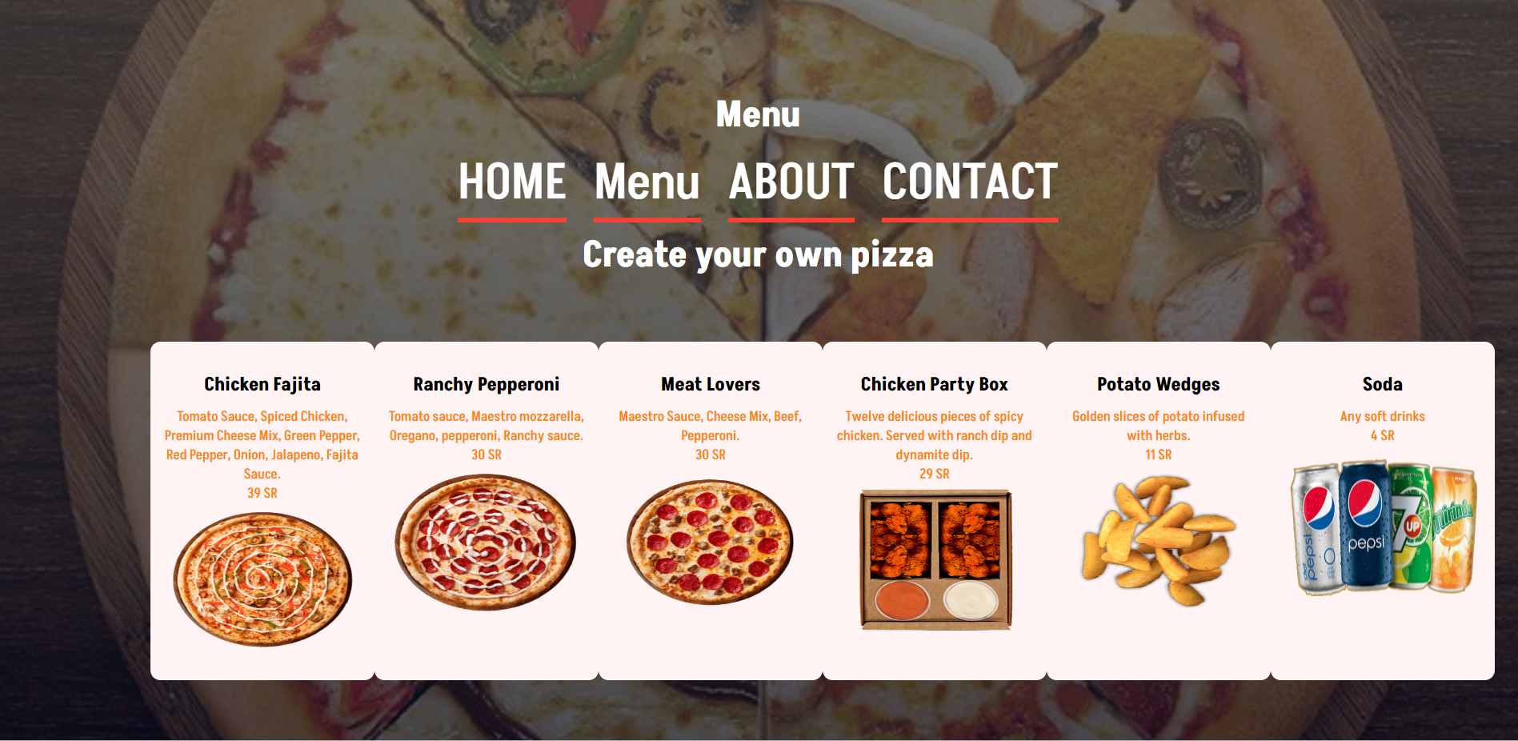

Slide 4
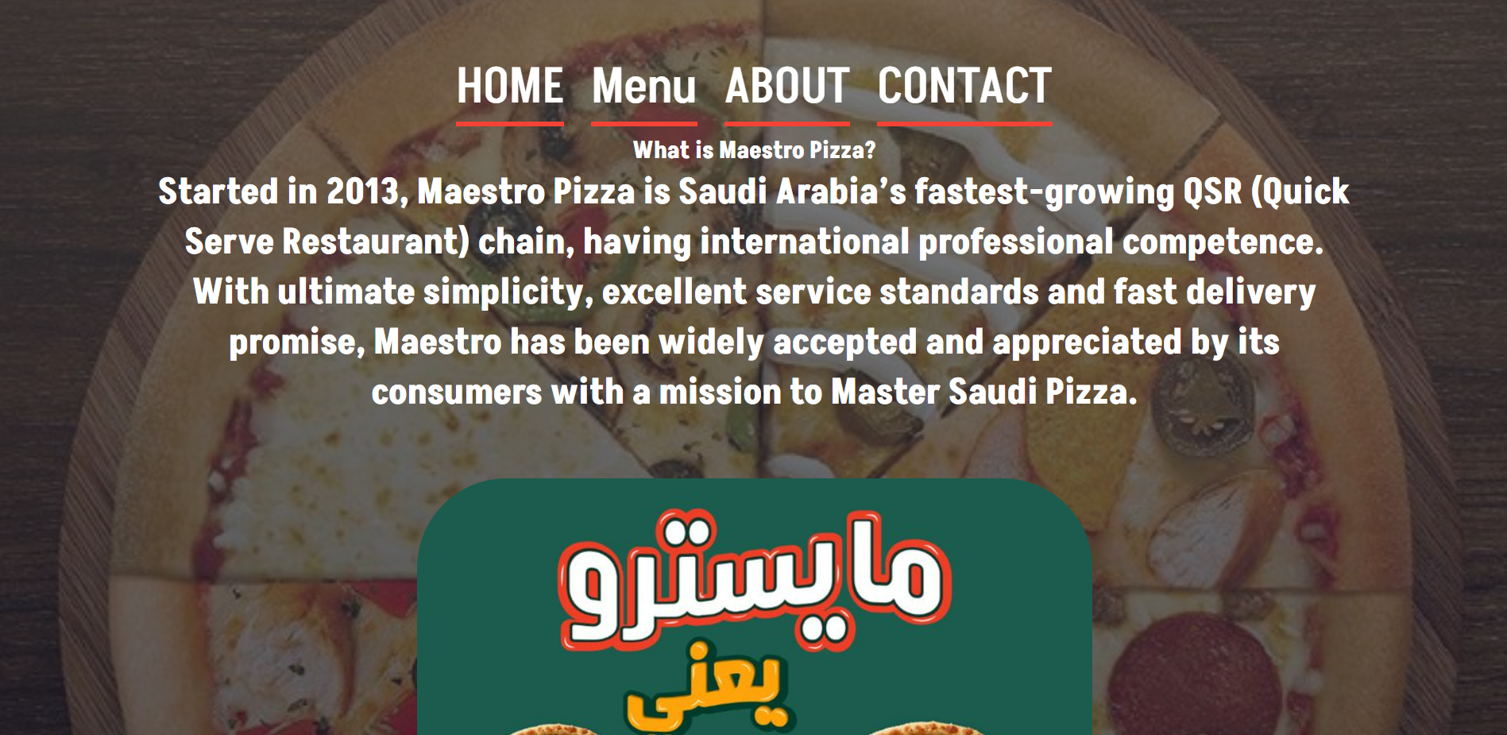

Slide 5


Slide 6
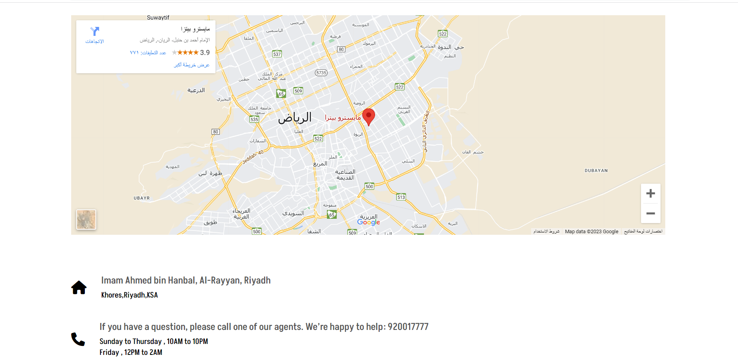

Slide 7
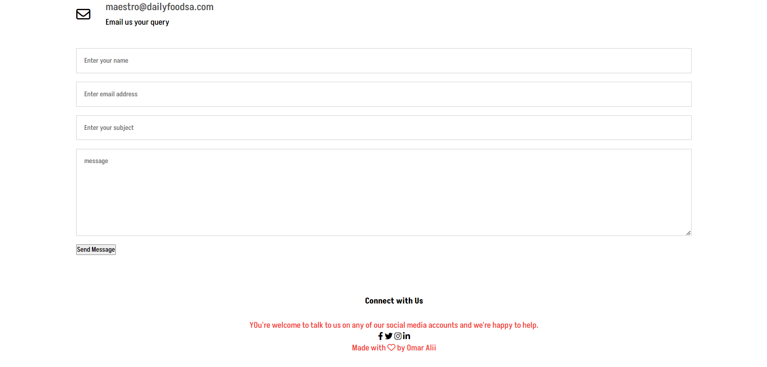

Slide 8


The end..
Any Question?

